Slide 1
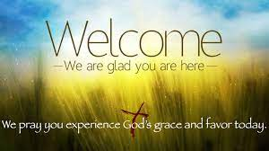

Slide 4
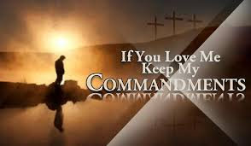

Slide 6
Lighting the Christ Candle

Slide 8
The Lord be with you
And Also With You

Slide 9
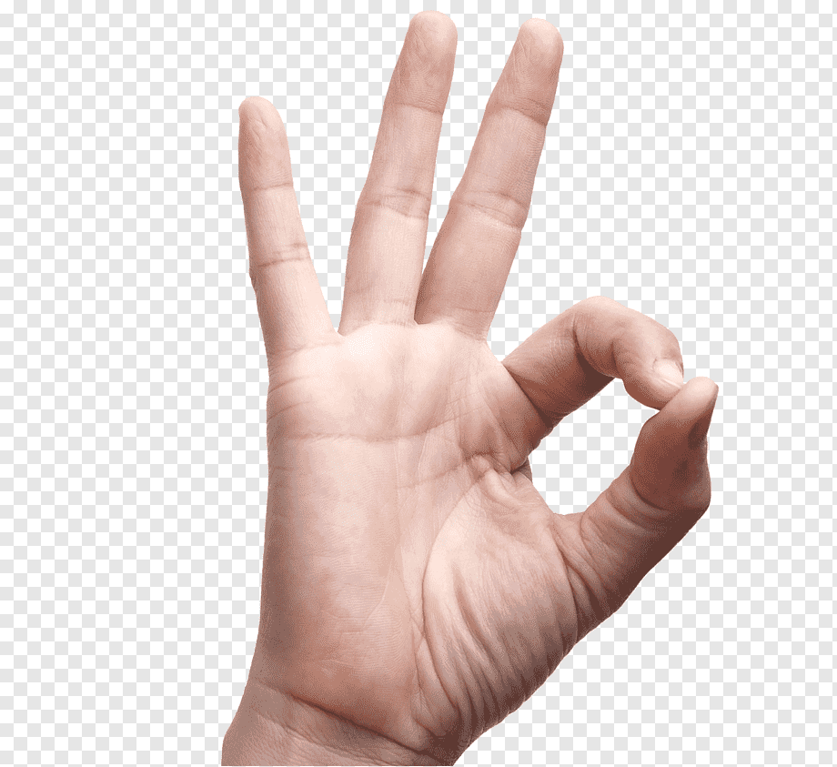
Sign of Peace

Slide 11
1 Sing to the LORD a new song, for He has done marvellous things; His right hand and His holy arm have worked salvation for Him.
2 The LORD has made His salvation known and revealed His righteousness to the nations.

Slide 12
3 He has remembered His love
and His faithfulness
to the house of Israel; all the ends of the earth have seen the salvation of our God.
4 Shout for joy to the LORD,
all the earth, burst into jubilant song with music;

Slide 13
5 make music to the LORD
with the harp, with the harp
and the sound of singing,
6 with trumpets
and the blast of the ram's horn— shout for joy before the LORD, the King.

Slide 14
7 Let the sea resound,
and everything in it, the world, and all who live in it.
8 Let the rivers clap their hands, Let the mountains sing together for joy;

Slide 15
9 let them sing before the LORD, for He comes to judge the earth. He will judge the world
in righteousness and the peoples with equity.
Amen

Slide 17
Father welcomes all His children to His family through His Son; Father giving His salvation, life for ever has been won.

Slide 18
Little children, come to me, for my kingdom is of these; life and love I have to give, mercy for your sin.

Slide 19
Father welcomes all His children to His family through His Son; Father giving His salvation, life for ever has been won.

Slide 20
In the water, in the word in His promise, be assured: those who are baptized and believe shall be born again.

Slide 21
Father welcomes all His children to His family through His Son; Father giving His salvation, life for ever has been won.

Slide 22
Let us daily die to sin, let us daily rise with Him, walk in the love of Christ our Lord, live in the peace of God.

Slide 23
Father welcomes all His children to His family through His Son; Father giving His salvation, life for ever has been won.

Slide 27
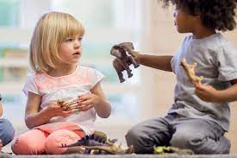

Slide 30
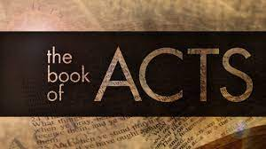

Slide 31
⁴⁴ While Peter was still speaking these words,
the Holy Spirit came on all who heard the message. ⁴⁵ The circumcised believers who had come with Peter were astonished that the gift of the Holy Spirit had been poured out even on Gentiles.
⁴⁶ For they heard them speaking in tongues and praising God.
Then Peter said, ⁴⁷ “Surely no one can stand in the way of their being baptized with water. They have received the Holy Spirit just as we have.”

Slide 32
⁴⁸ So he ordered that they be baptized in the name of Jesus Christ. Then they asked Peter to stay with them for a few days

Slide 34
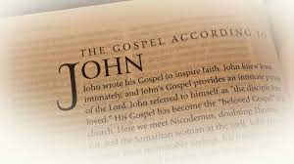

Slide 35
⁹ “As the Father has loved me, so have I loved you. Now remain in my love. ¹⁰ If you keep my commands, you will remain in my love, just as I have kept my Father’s commands and remain in his love. ¹¹ I have told you this so that my joy may be in you and that your joy may be complete.
¹² My command is this: Love each other as I have loved you. ¹³ Greater love has no one than this: to lay down one’s life for one’s friends.
¹⁴ You are my friends if you do what I command.

Slide 36
¹⁵ I no longer call you servants, because a servant does not know his master’s business. Instead, I have called you friends, for everything that I learned from my Father I have made known to you.
¹⁶ You did not choose me, but I chose you and appointed you so that you might go and bear fruit—fruit that will last—and so that whatever you ask in my name the Father will give you.
¹⁷ This is my command: Love each other.

Slide 38
A new commandment
I give unto you
That you love one another
As I have loved you
That you love one another
As I have loved you

Slide 39
By this shall all men know
That you are my disciples
If you have love one for another
By this shall all men know
That you are my disciples
If you have love one for another.

Slide 41
This Gospel, from the beginning, has emphasized the unity of Father & Son:
• “In the beginning was the Word, and the Word was with God, and the Word was God. The same was in the beginning with God. All things were made through him. Without him was not anything made that has been made” (1:1-3).
• Jesus has already said, “I and the Father are one” (10:30).
• In his high priestly prayer, shortly before his death, he will pray that the disciples “may be one, even as we are” (17:11, 22).

Slide 42
⁹ “As the Father has loved me, so have I loved you. Now REMAIN, dwell or tabernacle, a sense of stability, in my love.
¹⁰ If you keep my commands, you will remain, dwell in my love, just as I have kept my Father’s commands, a model of obedience, and remain, dwell, in his love.
¹¹ I have told you this so that MY joy may be in you and that YOUR joy may be COMPLETE. Not in lock step obedience but JOY!!!!

Slide 43
¹² My command is this: Love, (agape) each other as I have loved you. ¹³ Greater love has no one than this: to lay down one’s life for one’s friends. 1 Jn 3:16 Agape is unconditional Love, sacrificial love.
¹⁴ You are my friends if you do what I command.
The person who loves needs no commandment not to steal or kill, because the person who loves will not do those things.
It means that we stand with them even if we don’t agree with what they have done.
Matt 25:31-46 when did I see you …….

Slide 44
The Greeks have three words for love:
• Agape, a love characterized by concern for the welfare of the other person.
• Philos, companionate love (Philadelphia, which means the city of brotherly love, is derived from philos, which means love and adelphos, which means brother).
• Eros, romantic or sexual love.
Only agape and philos are used in the N T. In this Gospel, they are used somewhat interchangeably

Slide 45
¹⁵ I no longer call you servants, like Paul’s words, no Jew or gentile, slave or free, male or female, Gal 3:28, Col 3:10 , because a servant does not know his master’s business, a master gives orders, a friend communicates and shares. Instead, I have called you friends, philo,, for everything that I learned from my Father I have made known to you, no magic, but mystique.

Slide 46
¹⁶ You did not choose me, but I chose you and appointed you so that you might go and bear fruit—fruit that will last, remain, tabernacle —
and SO THAT WHATEVER YOU ASK IN MY NAME THE FATHER WILL GIVE YOU. What do we understand of this?? The person who abides in Christ—who becomes one with the Son as the Son is one with the Father—becomes so attuned to the will of God that God will give that person whatever he or she asks in Christ’s name.
¹⁷ This is my command: Love each other.

Slide 49
Our Father in heaven,
hallowed be Your name,
Your kingdom come,
Your will be done
On earth as in heaven.
Give us today our daily bread.

Slide 50
And forgive us our sins,
As we forgive those
who sin against us.
Save us from the time of trial,
And deliver us from evil.
For the kingdom, the power
and the glory are Yours,
Now and forever. Amen.

Slide 52
This is my will,
My one command,
That love should dwell
Among you all.
This is my will
That you should love
As I have shown
That I love you.
1/5

Slide 53
No greater love
Can be than this
To choose to die
To save one’s friends.
You are my friends
If you obey
What I command
That you should do.
2/5

Slide 54
I call you now
No longer slaves;
No slave knows all
Their master does.
I call you friends
For all I hear
My Father say
You hear from Me.
3/5

Slide 55
You chose not me
But I chose you
That you should go
And bear much fruit.
I chose you out
That you in me
Should bear much fruit
That will abide.
4/5

Slide 56
All that you ask
My Father dear
For my name’s sake
You shall receive.
This is my will
My one command,
That love shall dwell
In each, in all.
5/5

Slide 58
Good Morning
We hope you have a great week

Slide 59
